Slide 1

ABAPConf South Africa 2024
Introduction to ABAP Cloud - working towards a Clean Core
Thabiso Ramarou, EPI-USE Africa

Slide 2
Agenda
Introduction to Clean Core Concepts and ABAP Cloud
ABAP Cloud Architecture and Design Principles
Key Features of ABAP Cloud
Best Practices for Developing Cloud-Native Solutions in ABAP Cloud
Leveraging ABAP Cloud for Flexibility and Sustainability
How do I get started

Slide 3
Objectives
Introduce ABAP Cloud and its significance in maintaining a clean core within SAP systems.
Explore the architecture and key features of ABAP Cloud.
Share best practices for developing cloud-native solutions that uphold the integrity of the SAP core.
Demonstrate how ABAP Cloud can be leveraged to enhance flexibility and sustainability in SAP development projects.
Equip attendees with practical knowledge to adopt ABAP Cloud effectively in their SAP environments.

Slide 4
Clean Core: What is this core?
Introduction to ABAP Cloud and Clean Core Concepts
ABAPConf South Africa 2024

Slide 5
What is this core?
Software Stack
Extensibility
Integrations
Processes
Data
Operations
The versions of the foundational standard software in use; e.g.. enterprise resource planning (ERP), database, etc.
Functionality added to standard software which extends it to address organizational needs that are not met by standard.
Communication between extensions and standard solution as well as
communication between solutions.
The series of actions or steps taken within your system that cover the end-to-end (E2t) experience of delivering an outcome.
Three types of information in the system: Configuration data, Master data, Transactional data.
Governance responsible for managing infrastructure, upgrade decisions,
extension decisions, and system monitoring and maintenance activities.
Introduction to ABAP Cloud and Clean Core Concepts
ABAPConf South Africa 2024

Slide 6
What is clean?
Up to Date: The system can easily adopt the latest SAP updates, patches, and enhancements without complex rework. This means reduced effort for maintenance and faster access to new features and improvements.
Transparent: Transparency in a clean system means clear visibility into customizations, configurations, and enhancements. It enables easy monitoring and auditability, helping identify what has been modified or extended and making it easier to manage changes across different environments.
Unmodified: A clean system is free from direct modifications to the standard SAP codebase. This principle is key in SAP’s "clean core" strategy, where the core software remains untouched, while all customizations and extensions are achieved using in-app extensibility (such as user interfaces or custom fields) or side-by-side extensibility on SAP BTP.
Consistent: Consistency refers to standardized data and processes across the system, reducing complexity and errors. Consistent configurations and extensions make it easier to maintain, troubleshoot, and align with SAP best practices, ensuring that different parts of the system operate seamlessly together.
Efficient: Efficiency implies streamlined operations and optimized performance without excessive overhead from customizations or outdated modifications. A clean system can perform better because it avoids unnecessary or redundant processes introduced by unsupported changes.
Cloud Compliant: Cloud compliance means the system adheres to the principles and architecture of cloud solutions, including scalability, security, and standardized APIs. In a cloud-compliant system, extensions are made without altering the core system, making it suitable for cloud platforms like SAP S/4HANA Cloud, which requires a clean core to support future innovations and seamless upgrades.
Introduction to ABAP Cloud and Clean Core Concepts

Slide 7
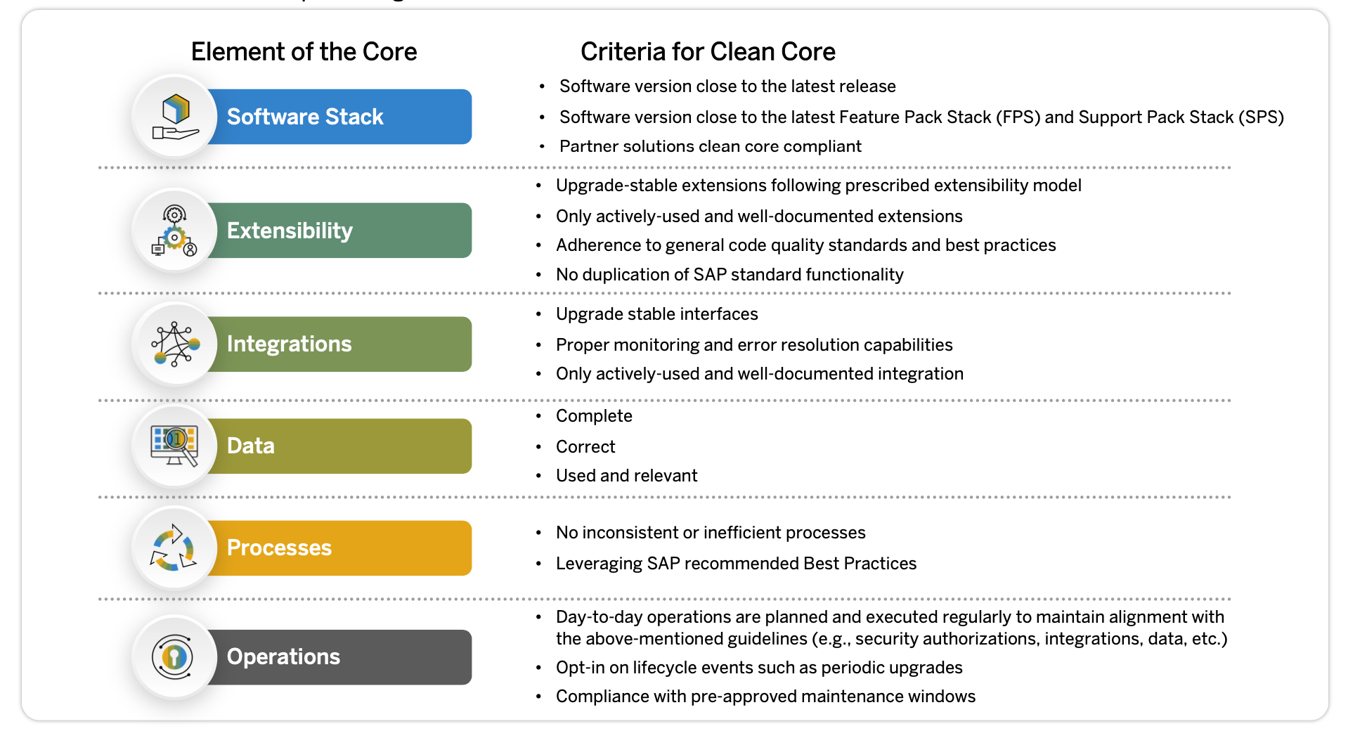
What is clean core?
Introduction to ABAP Cloud and Clean Core Concepts

Slide 8
Clean core - guiding principles
Avoid
Avoid extensions where not necessary.
Stay as close as possible to
SAP standard.
Clean Core
Be aware
Know your technical debts and evaluate them on a regular basis.
Establish a binding governance framework.
Cloud ready
Extend and integrate in a stable and transparent manner.
Apply a zero-modification policy.
Decouple
Leverage SAP Business Technology Platform (SAP BTP) as a platform to innovate for additional differentiation.
Automate with standard APls and events.
Introduction to ABAP Cloud and Clean Core Concepts

Slide 9
Extensibility Keeping extensions clean
Introduction to ABAP Cloud and Clean Core Concepts
ABAPConf South Africa 2024

Slide 10
Why we need extensions
Required scope
Required by clients
Delivered scope
SAP standard software
Differentiating scope
Competitive advantage for Business. The unique sauce for your business. Business does not want this to be part of SAP standard
Covered scope
Required by clients, and covered by SAP standard
Extensibility
ABAPConf South Africa 2024

Slide 11
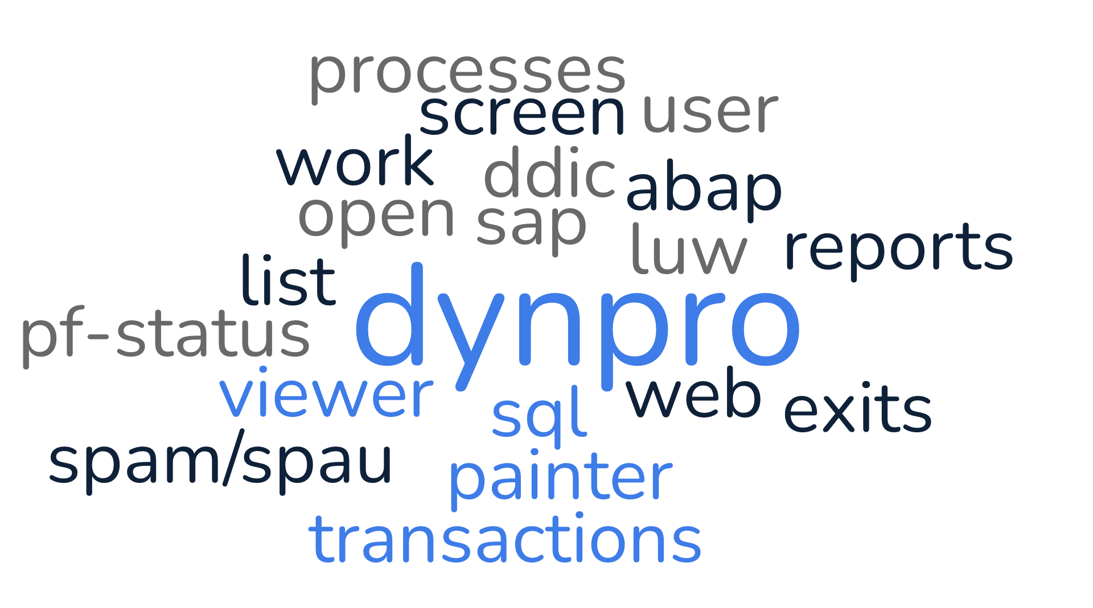
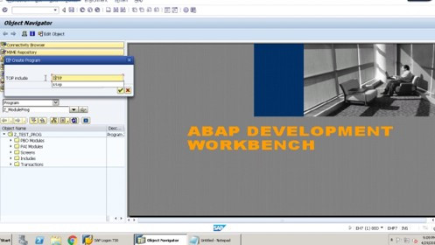
Classic Extensibility
Extensibility
ABAPConf South Africa 2024

Slide 12
Classic Extensibility: the bad parts
Upgrade Complexity: Classic extensions can complicate system upgrades. Since they often involve modifying or enhancing standard SAP code, they may need to be manually adjusted or reimplemented during upgrades, increasing time and cost.
High Maintenance Effort: Extensions through classic methods can create dependencies and introduce technical debt, making ongoing maintenance more challenging. They require additional testing whenever there are changes or updates in the system.
Performance Impact: Poorly implemented enhancements or modifications can degrade system performance and health.
Incompatibility with Cloud Environments: Classic extensibility methods, are not compatible with modern cloud platforms, such as SAP S/4HANA Public Cloud, which emphasizes clean core principles and requires a different approach to extensibility, like using in-app and side-by-side extensibility.
Extensibility
ABAPConf South Africa 2024

Slide 13
Transitioning to clean extensions
Clean core extensibility can be summarized as an extension methodology where extensions are kept strictly separate from the SAP application. Extensions access SAP business objects only through well defined, upgrade-stable interfaces".
Adopting a policy of zero modifications​
Eliminating enhancements that are redundant to standard code and functionality and also eliminating copies of SAP objects​
Using released APIs only ("upgrade-stable interfaces")​
Leveraging the key user (in-app) extensibility of SAP S/4HANA Cloud to its full extent​
Employing the capabilities and services offered by SAP Business Technology Platform to build larger extension applications​
Using SAP Integration Suite​
Introduction to ABAP Cloud and Clean Core Concepts

Slide 14
Transitioning to clean extensions: Rules for smooth software updates: Extensions must be clearly separated from SAP Standard Code In Public Cloud: No modifications to SAP objects allowed. In Private Cloud and on-premise: Only stable public SAP APIs (local or remote) and SAP extension points can be used.
Introduction to ABAP Cloud and Clean Core Concepts

Slide 15
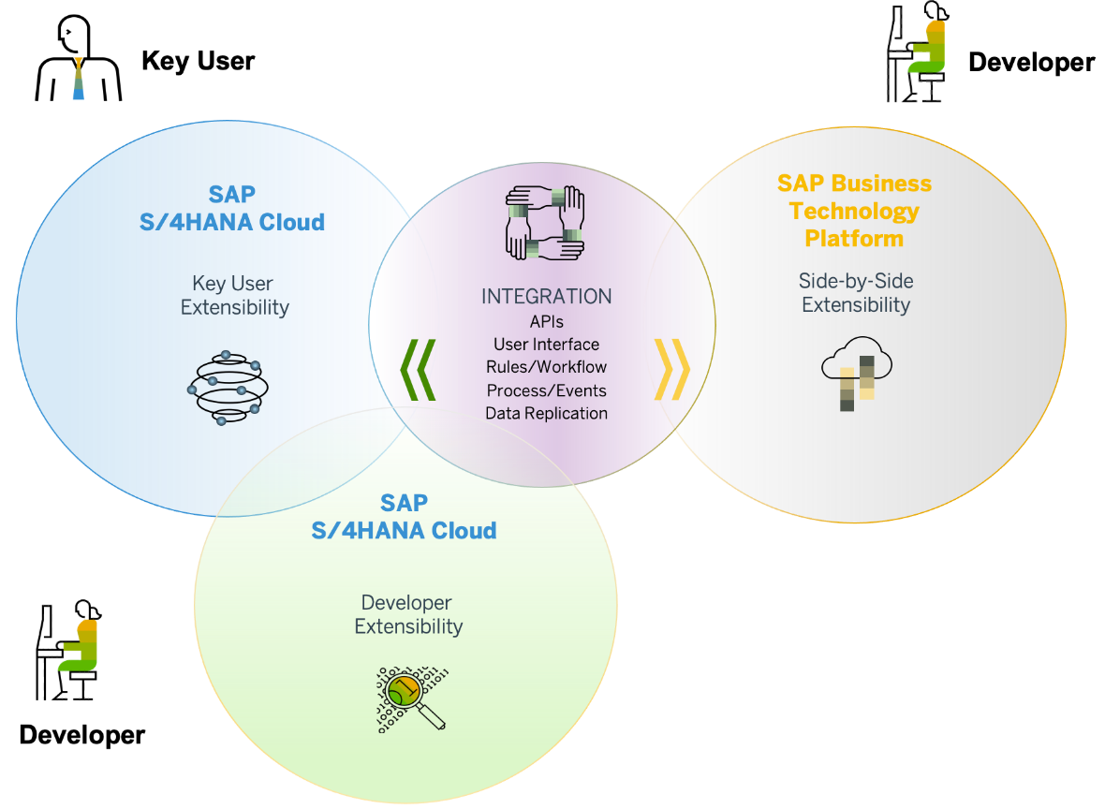
Extensibility Model in SAP S/4HANA: Key user (in-app) Extensibility
Two personas:
Key user
Developer
Introduction to ABAP Cloud and Clean Core Concepts

Slide 16
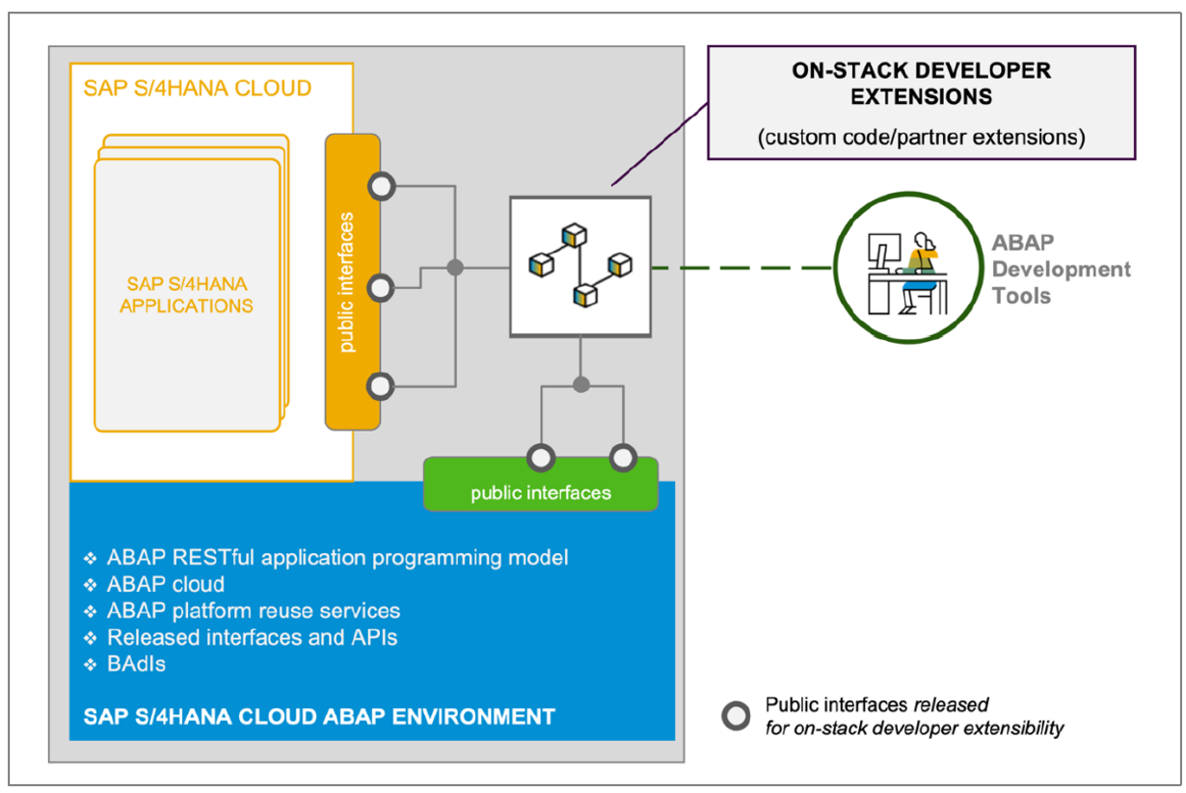
Extensibility Model in SAP S/4HANA: Developer (on-stack) extensibility
Introduction to ABAP Cloud and Clean Core Concepts

Slide 17
Extensibility Model in SAP S/4HANA: Side-By-Side Extensibility
SAP BTP
SAP Solution
e.g.
S/4 HANA Cloud /
SuccessFactors /
Employee Central Payroll
SAP BTP ABAP environment
ABAP
/RAP
SAP BTP Cloud Foundry environment
Secure connectivity
Java/
NodeJS
/CAP
Java/
NodeJS
/CAP
SAP BTP Kyma environment
- Decoupled
- remote APIs which are published in the SAP API Hub (https://api.sap.com/).
Introduction to ABAP Cloud and Clean Core Concepts

Slide 18

Cloud
Introduction to ABAP Cloud and Clean Core Concepts
ABAPConf South Africa 2024

Slide 19
Enter of ABAP Cloud: What is ABAP Cloud?
ABAP Cloud is the ABAP development model to build cloud-ready business apps, services or extensions. It comes with SAP BTP and SAP S/4HANA and it works with public or private cloud, and even on-premise.
Introduction to ABAP Cloud and Clean Core Concepts

Slide 20
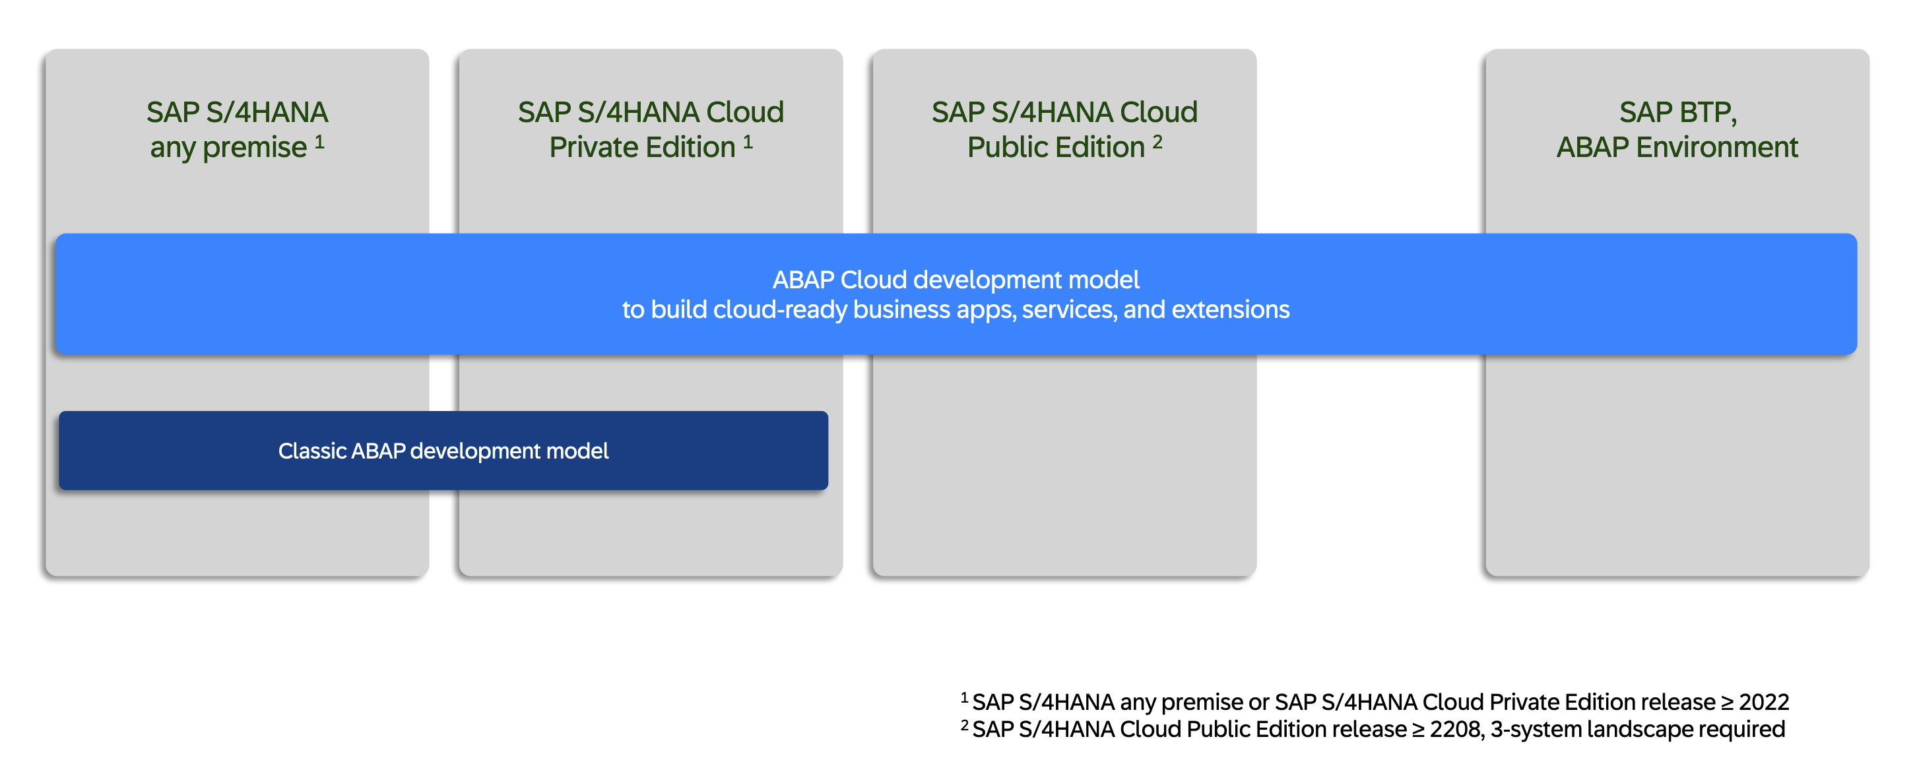
Where can I use ABAP Cloud?
Introduction to ABAP Cloud and Clean Core Concepts

Slide 21
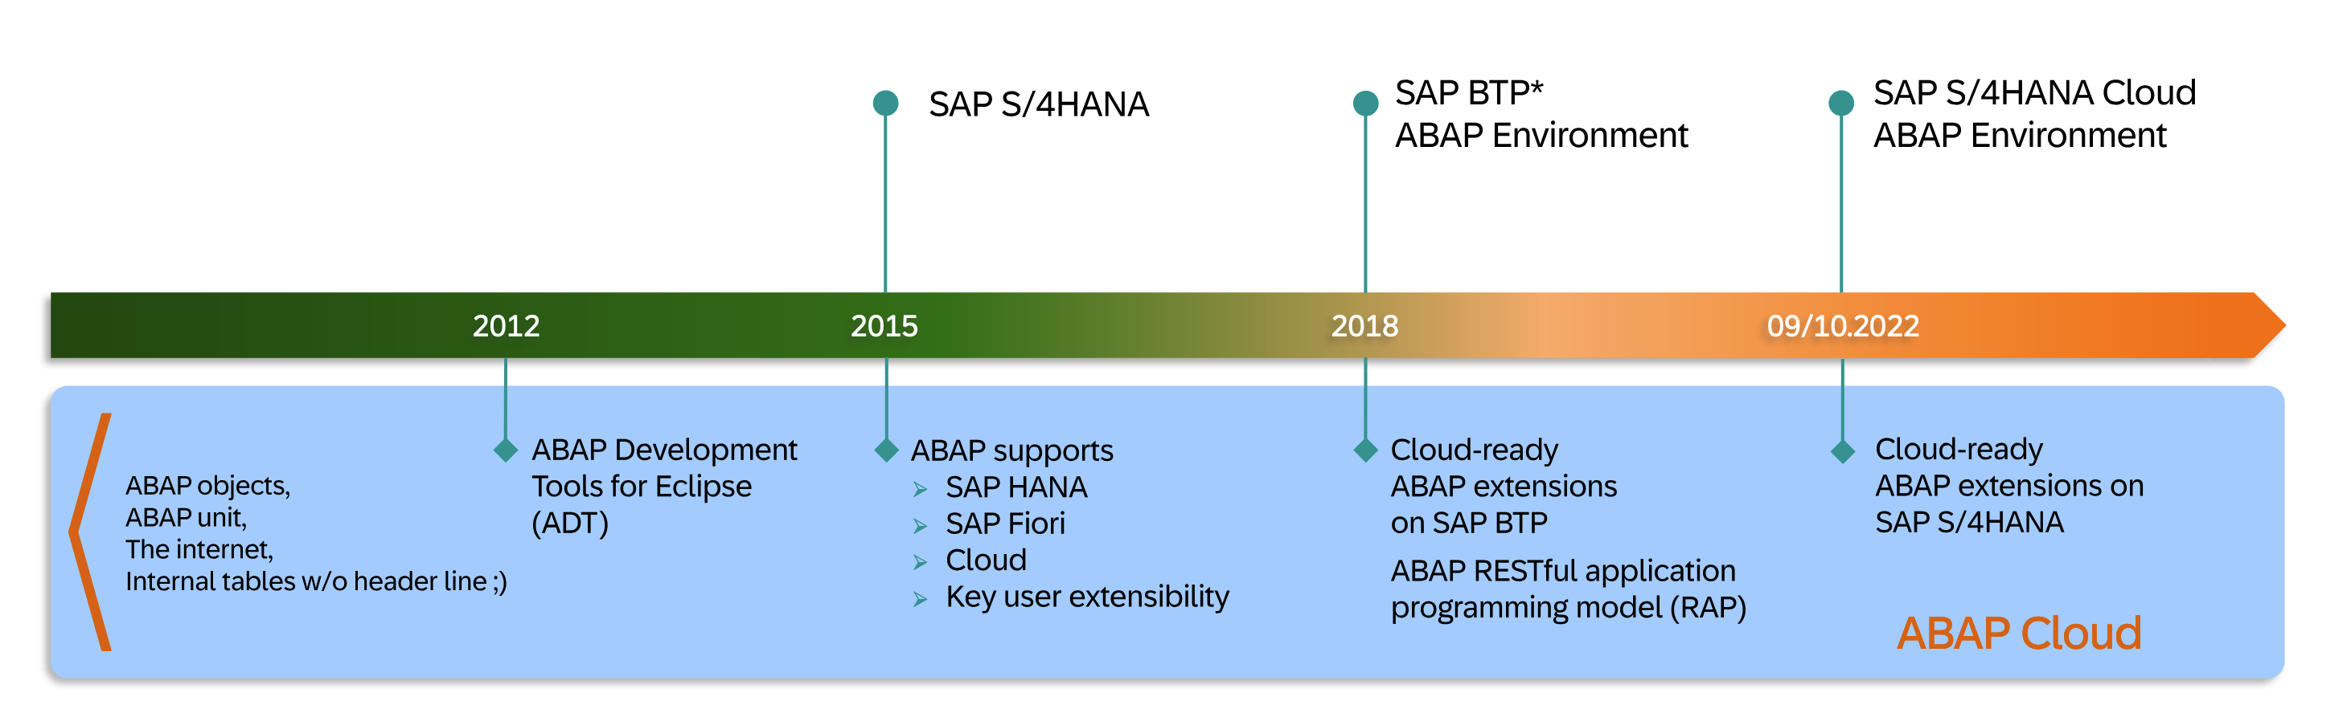
Evolution of ABAP Cloud
Introduction to ABAP Cloud and Clean Core Concepts

Slide 22
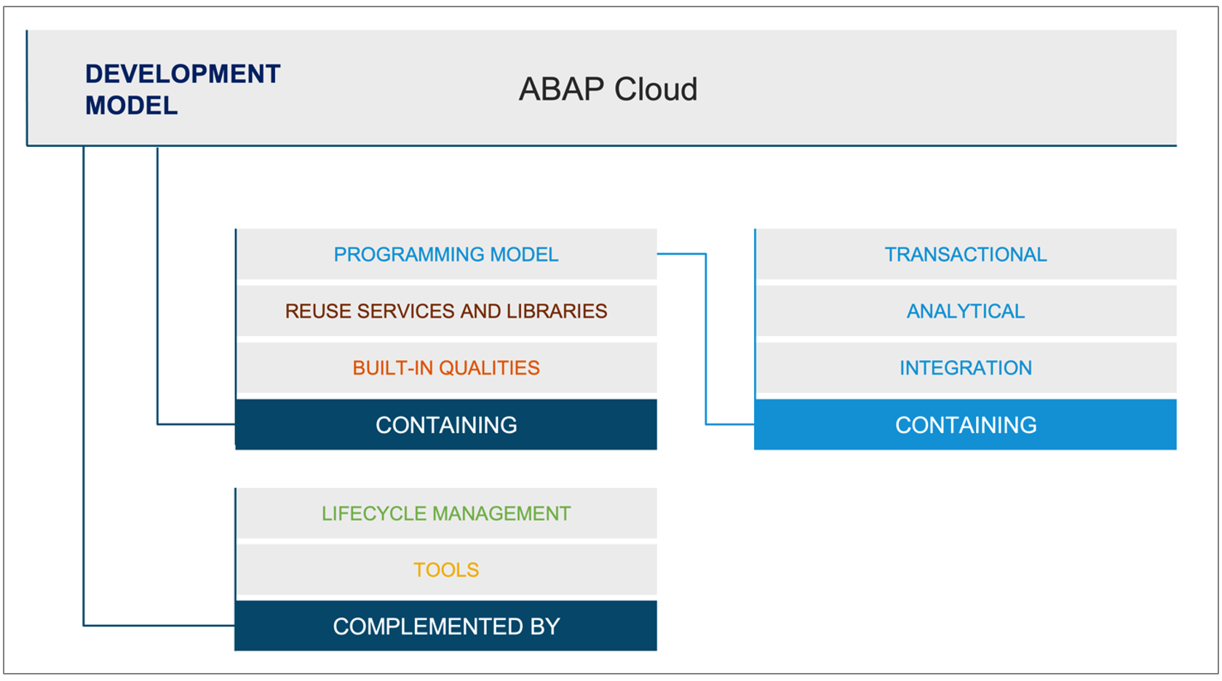
ABAP Cloud Model
ABAP language, Core Data Services, RAP etc.
Out of the box functionality provided, For example application jobs
Built in qualities like cloud qualities and
Code quality.
ABAP Design time and Runtime
Optimised toolsets for different personas
Introduction to ABAP Cloud and Clean Core Concepts

Slide 23
SAP BTP ABAP environment
SAP BTP ABAP environment is the platform as a service for ABAP developers. It’s a cloud-optimized ABAP platform based on SAP HANA Cloud that serves as a development and runtime environment for cloud apps.
SAP Offers a trail BTP Environments : https://cockpit.hanatrial.ondemand.com/trial/#/home/trial
ABAP Developer Tools:
Eclipse download: https://www.eclipse.org/downloads/
ADT: https://tools.hana.ondemand.com/
Introduction to ABAP Cloud and Clean Core Concepts
ABAPConf South Africa 2024

Slide 24
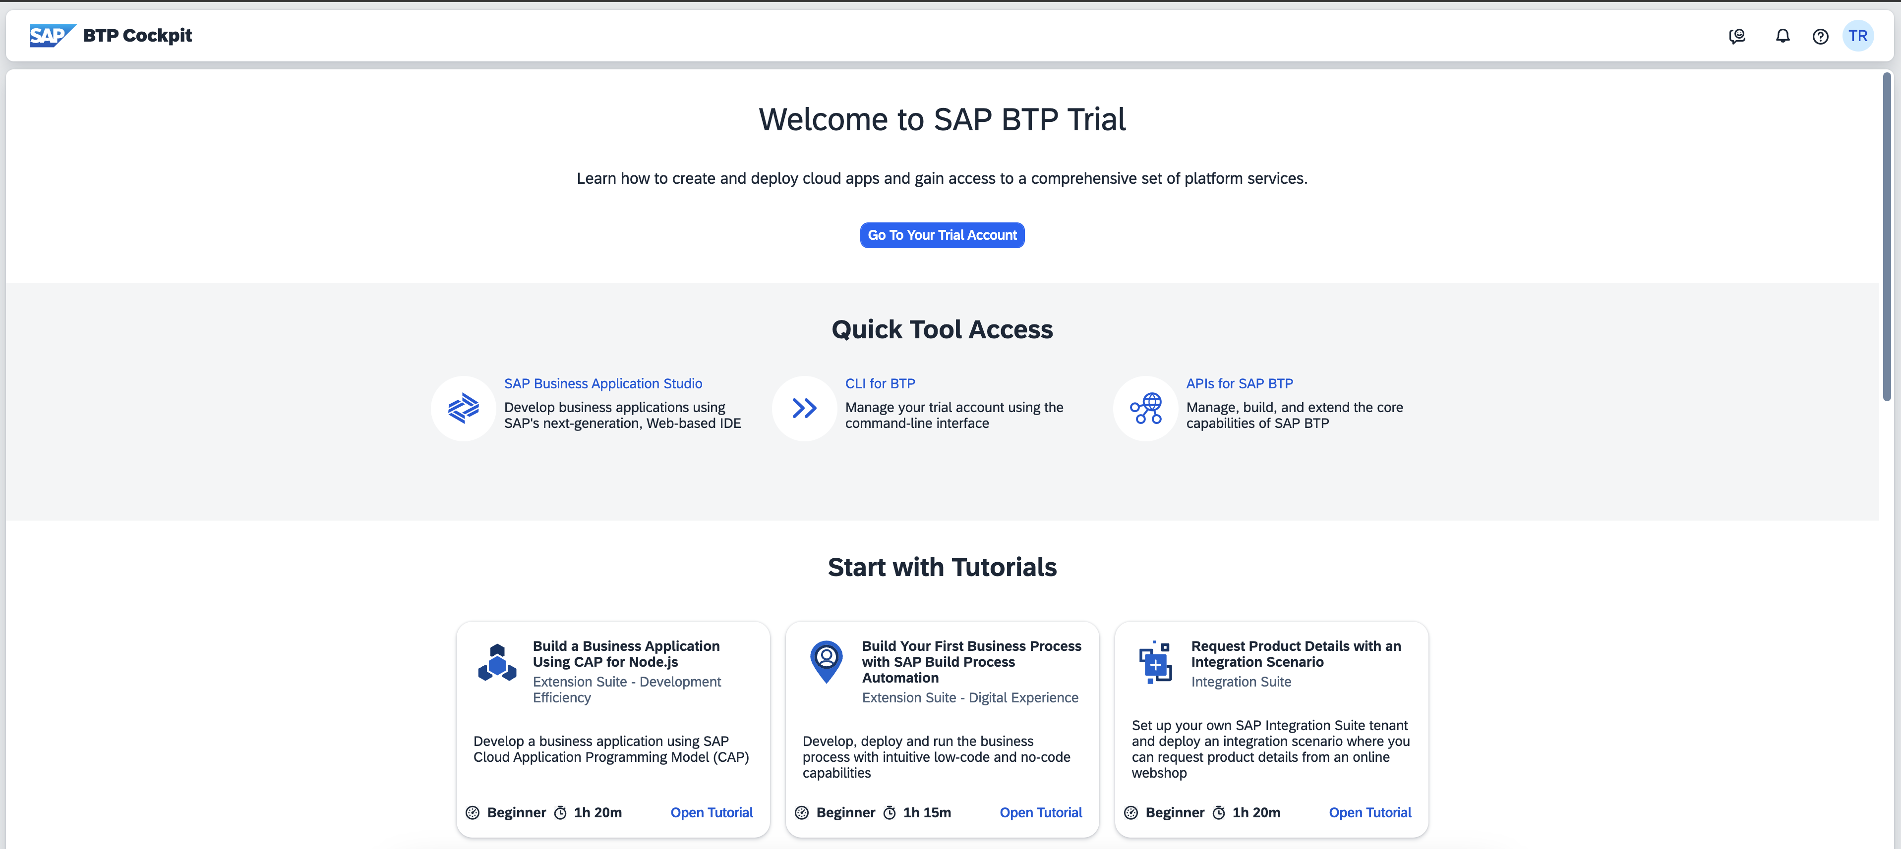
ADT Connecting to SAP BTP ABAP environment
https://cockpit.hanatrial.ondemand.com/trial/#/home/trial
Introduction to ABAP Cloud and Clean Core Concepts
ABAPConf South Africa 2024

Slide 25
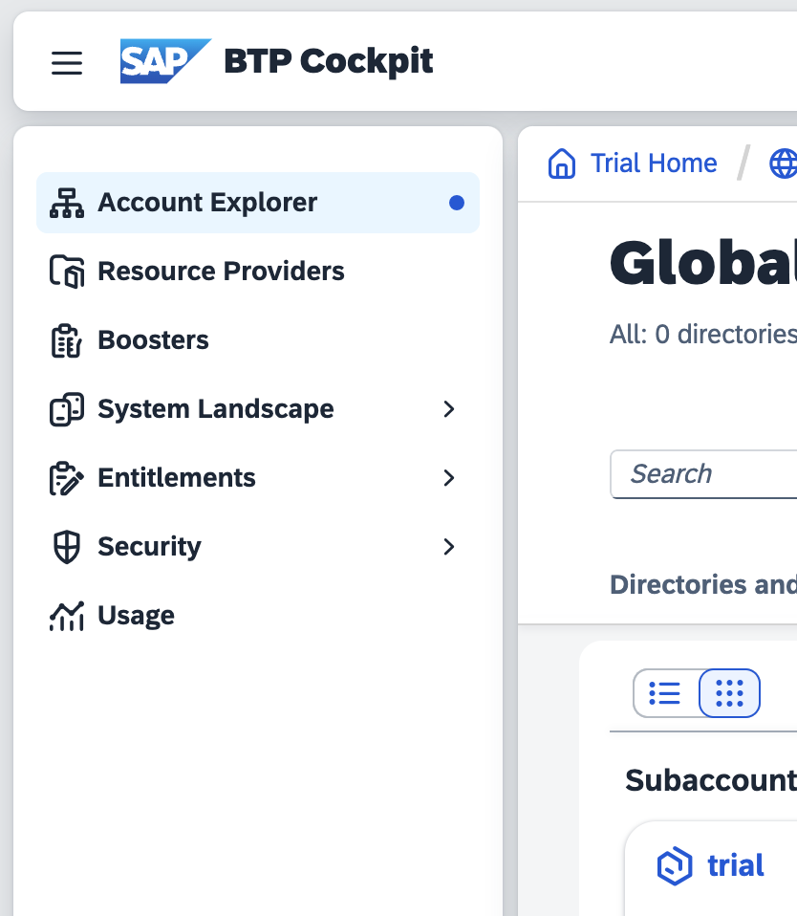
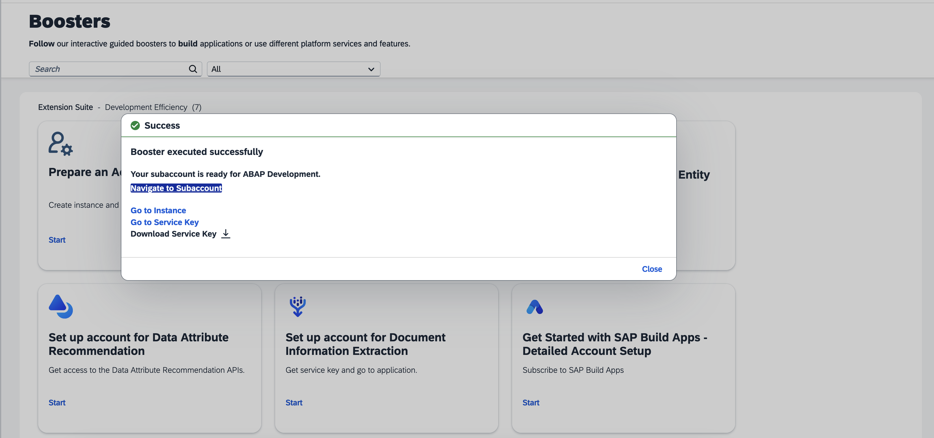
ADT Connecting to SAP BTP ABAP environment
Introduction to ABAP Cloud and Clean Core Concepts
ABAPConf South Africa 2024

Slide 26
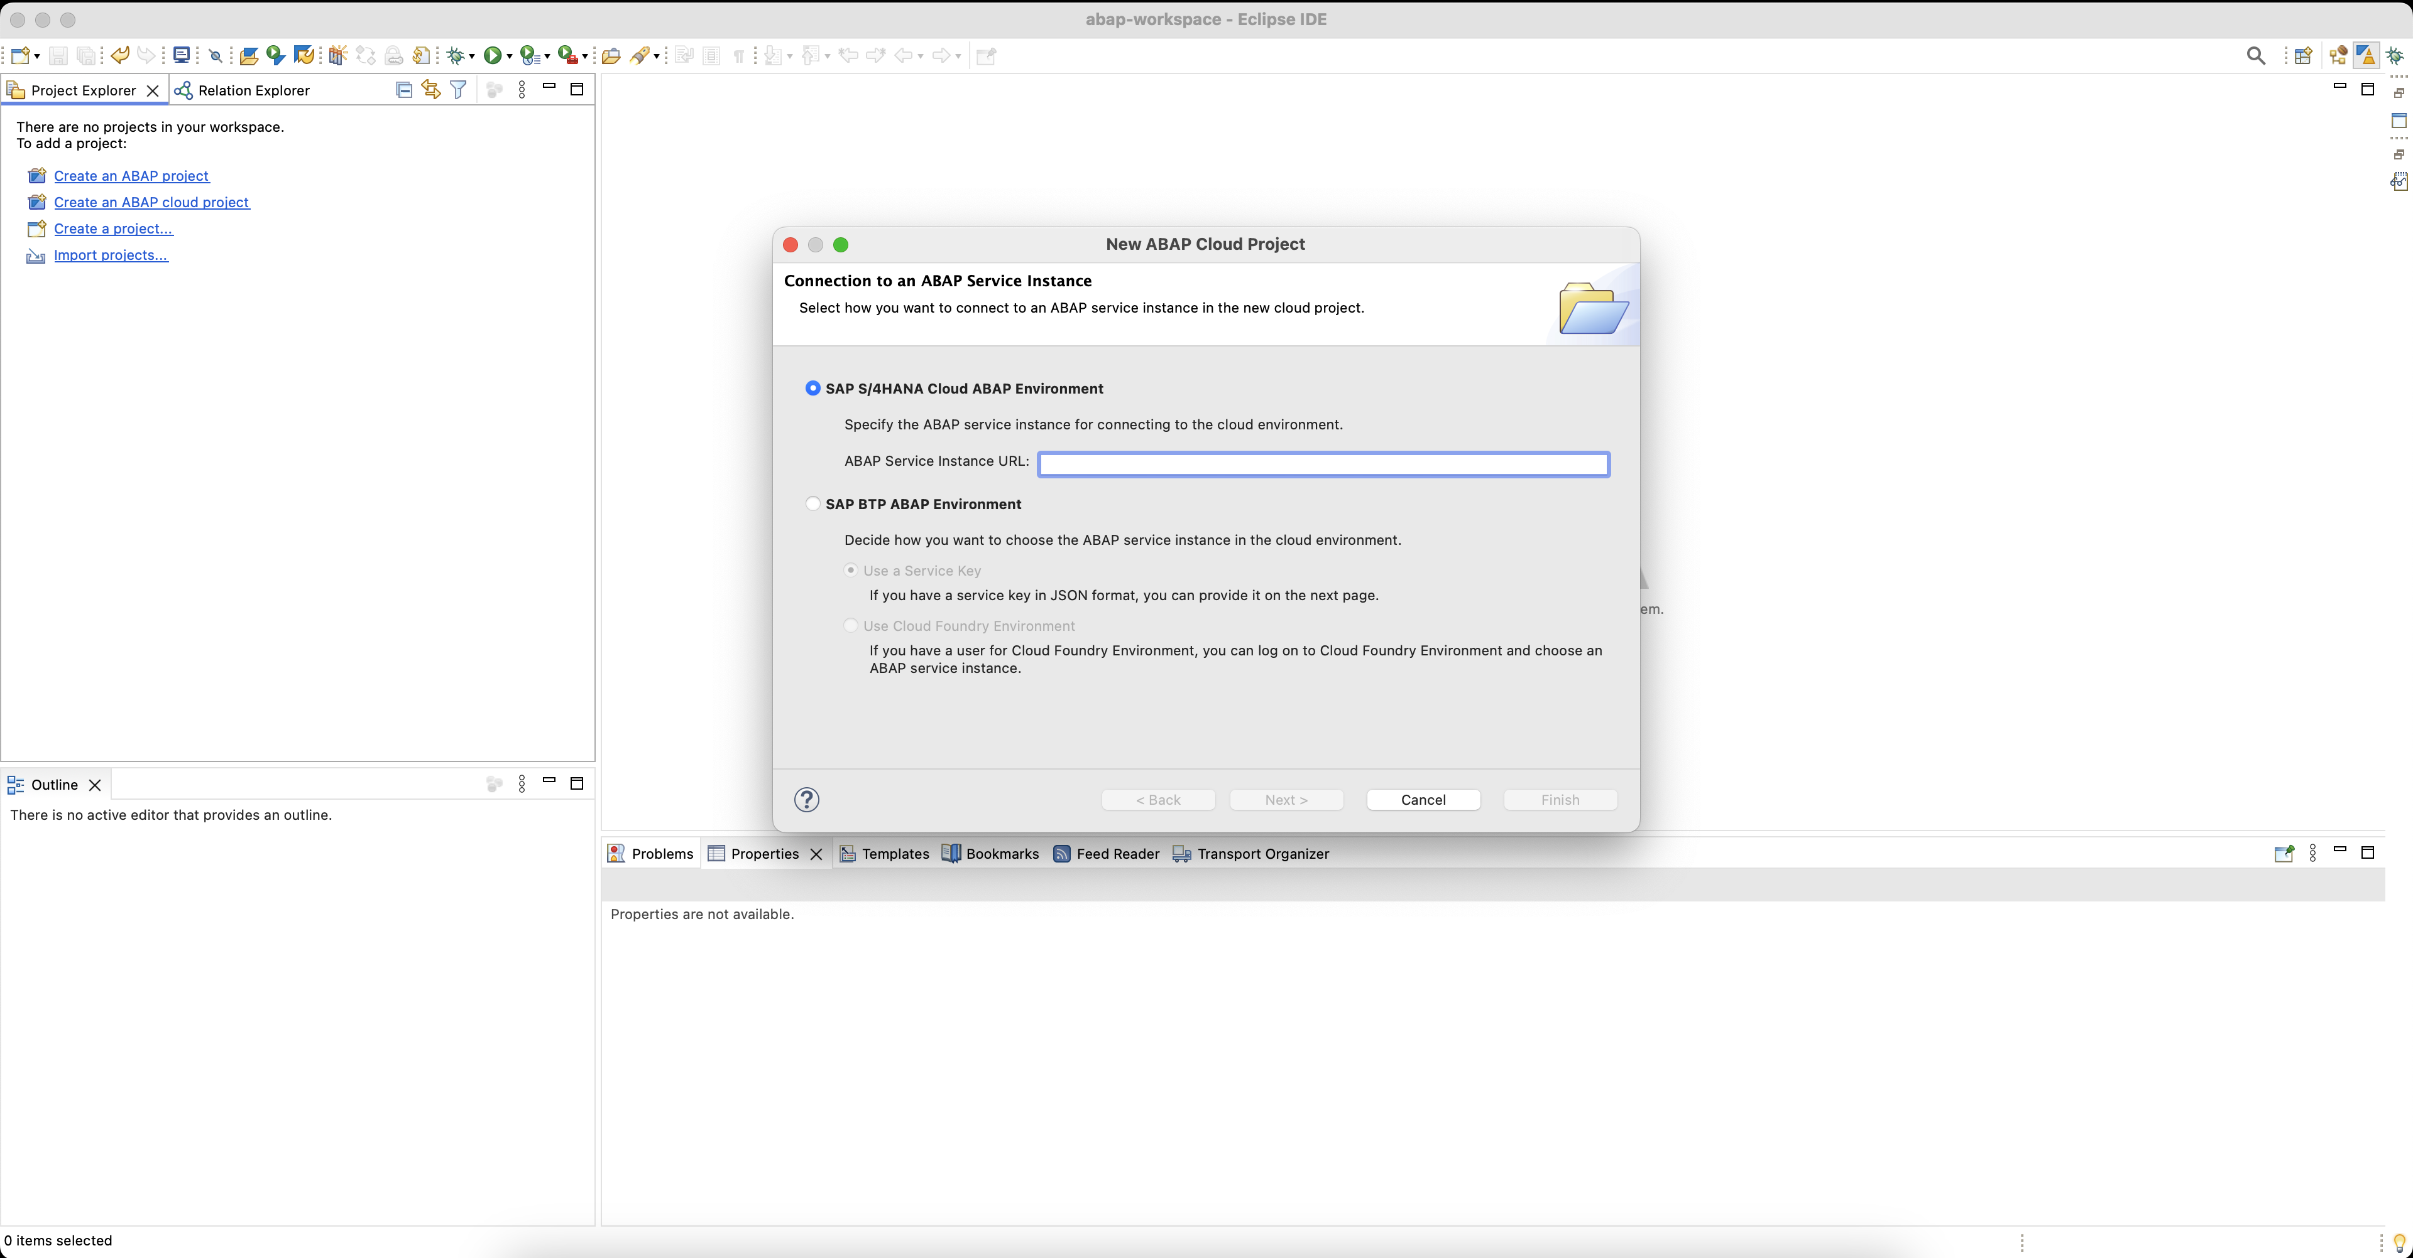
ADT Connecting to SAP BTP ABAP environment
Introduction to ABAP Cloud and Clean Core Concepts
ABAPConf South Africa 2024

Slide 27
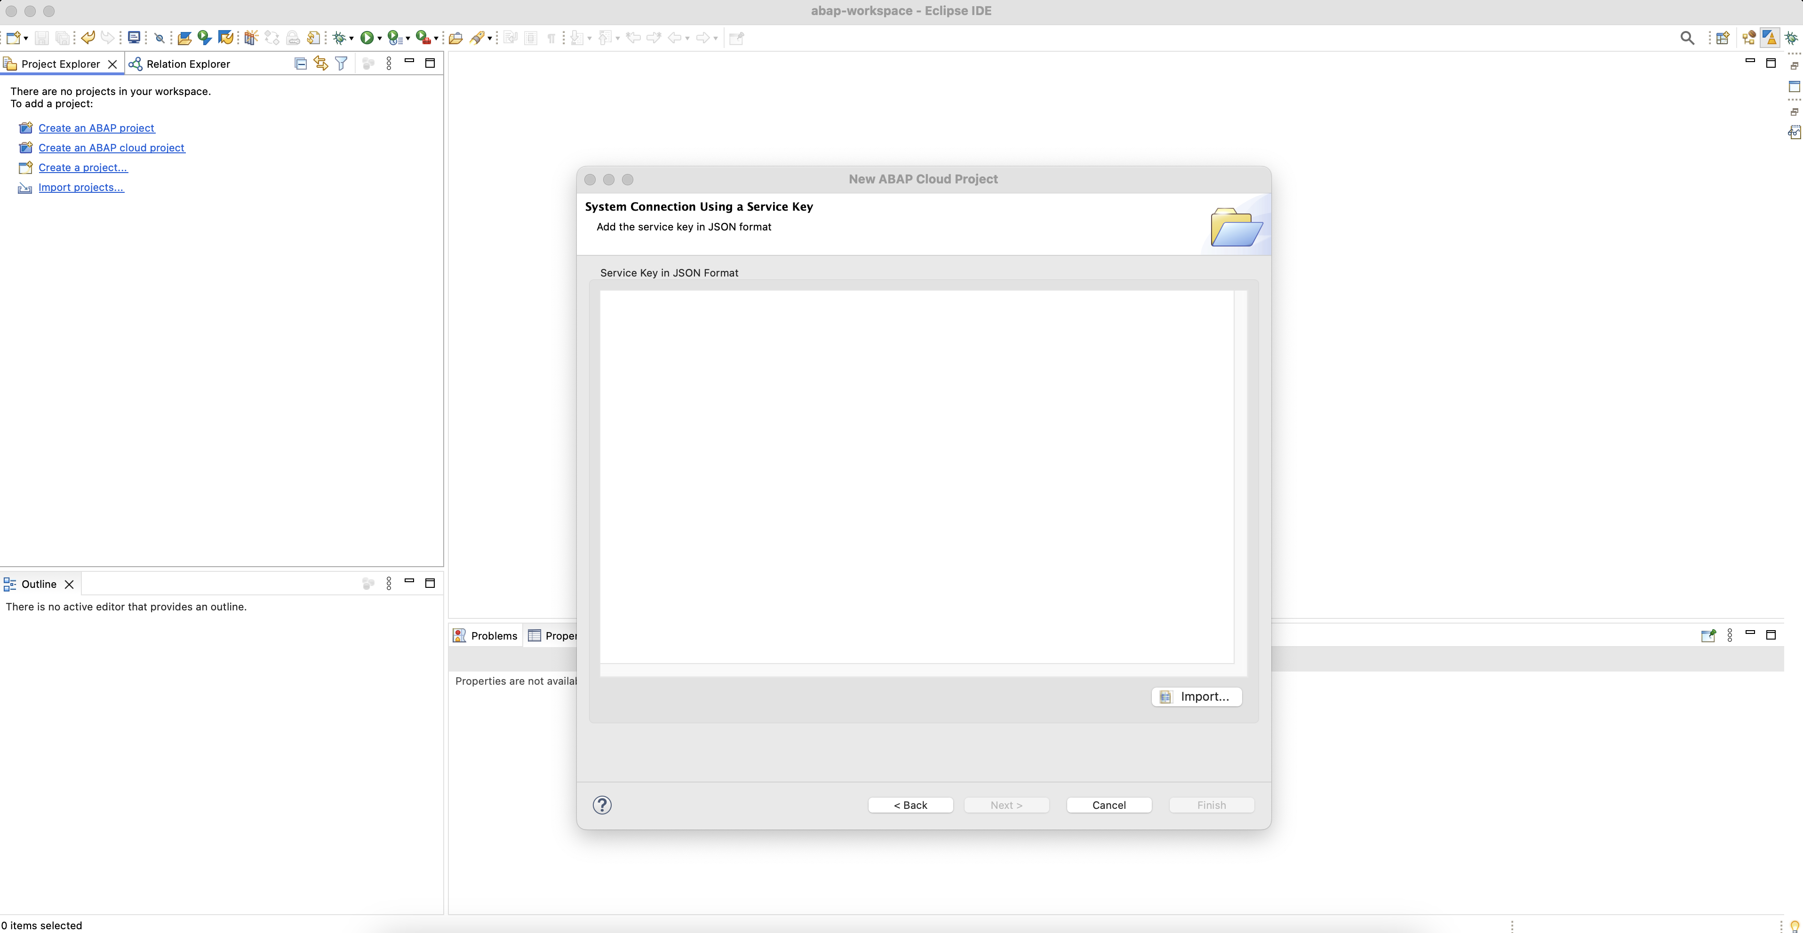
ADT Connecting to SAP BTP ABAP environment
Introduction to ABAP Cloud and Clean Core Concepts
ABAPConf South Africa 2024

Slide 28
ABAP RESTful Application Programming Model (RAP)
Introduction to ABAP Cloud and Clean Core Concepts
ABAPConf South Africa 2024

Slide 29
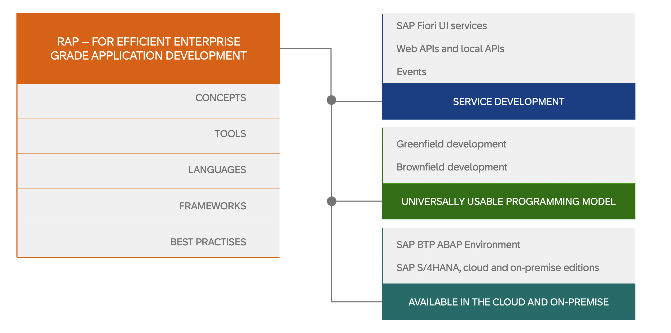
ABAP Cloud: ABAP RESTful Application Programming Model (RAP)
RAP is a set of concepts, tools, languages, and powerful frameworks that help developers to build innovative, cloud-ready SAP Fiori applications, local and Web APIs; and to easily extend SAP standard applications on the ABAP platform, in the cloud as well as on-premise.
Introduction to ABAP Cloud and Clean Core Concepts

Slide 30
ABAP RESTful Application Programming Model (RAP)
https://pages.community.sap.com/topics/abap/rap
https://pages.community.sap.com/topics/abap/rap#basics
Introduction to ABAP Cloud and Clean Core Concepts
ABAPConf South Africa 2024

Slide 31
References
https://www.sap.com/documents/2022/10/52e0cd9b-497e-0010-bca6-c68f7e60039b.html
https://www.sap.com/documents/2022/11/96974181-4f7e-0010-bca6-c68f7e60039b.html
https://www.sap.com/documents/2023/05/74fc05e6-747e-0010-bca6-c68f7e60039b.html
https://help.sap.com/docs/abap-cloud/abap-cloud/abap-cloud-in-nutshell
https://help.sap.com/docs/abap-cloud/abap-cloud/why-abap-cloud
https://community.sap.com/t5/enterprise-architecture-blog-posts/why-business-need-to-adapt-a-clean-core-design/ba-p/13724914
https://community.sap.com/t5/technology-blogs-by-sap/clean-core-demystified-what-does-it-mean-and-how-to-achieve-it-with-sap-btp/ba-p/13550604
https://community.sap.com/t5/enterprise-resource-planning-blogs-by-sap/sap-s-4hana-extensibility-options-for-clean-core-journey/ba-p/13568992#comment-674866
https://community.sap.com/t5/enterprise-resource-planning-blogs-by-sap/abap-cloud-sap-s-4hana-extensibility-may-2023-update/ba-p/13566523
Introduction to ABAP Cloud and Clean Core Concepts

